Slide 1

Transformers in NLP
Submitted By -:
Nipun Singh Rathore, 9920103205
Ayushi Bawari, 9920103216
Under the supervision of -:
Ms. Akanksha Mehndiratta
Department Of Computer Science & Engineering And Information Technology
Jaypee Institute Of Information Technology, Noida

Slide 2
Problem Statement
This project is dedicated to conducting a in-depth study of transformer models in the realm of NLP. The primary objective of this project includes understanding the architectural design, the pre-training methodologies, fine-tuning strategies, all constituent layers, and then pre-training a transformer model from scratch.
By understanding the core concepts behind Transformers, such as self-attention mechanisms and positional encoding, we aim to harness their capabilities to achieve superior performance in tasks like question answering, text classification and more.

Slide 3
Objectives
Implement a transformer model from scratch.
Incorporate attention mechanisms to capture contextual information.
Develop encoder and decoder components.
Integrate word and positional embeddings for understanding text structure.
Implement masked language model (MLM) and next sentence prediction (NSP) pre-training objectives.
Encapsulate all components to create a complete transformer model architecture.
Utilize the transformer model for NLP tasks, such as question answering.
Compare the performance of the custom transformer with existing pre-trained models like BERT.

Slide 4
Work Done
Implemented Scaled Dot Product Attention and Multi-Head Self Attention mechanisms.
Developed Encoder and Decoder blocks for sequence processing.
Created Word and Positional Embeddings which are inputs to the Encoder block.
Combined all components to construct the Transformer Architecture within a class.
Conducted comparisons of Tokens and Embeddings with Distill-BERT's representations.

Slide 5
Work Done (continued)
Leveraged Hugging Face Pipelines to explore various Natural Language Processing (NLP) tasks.
Implemented Masked Language Model (MLM) and Next Sentence Prediction (NSP) pre-training objectives.
Developed a Flask application to facilitate question answering using our model and BERT model.
Established a comprehensive test suite to validate the functionality and performance of the application.

Slide 6
Results

Slide 7
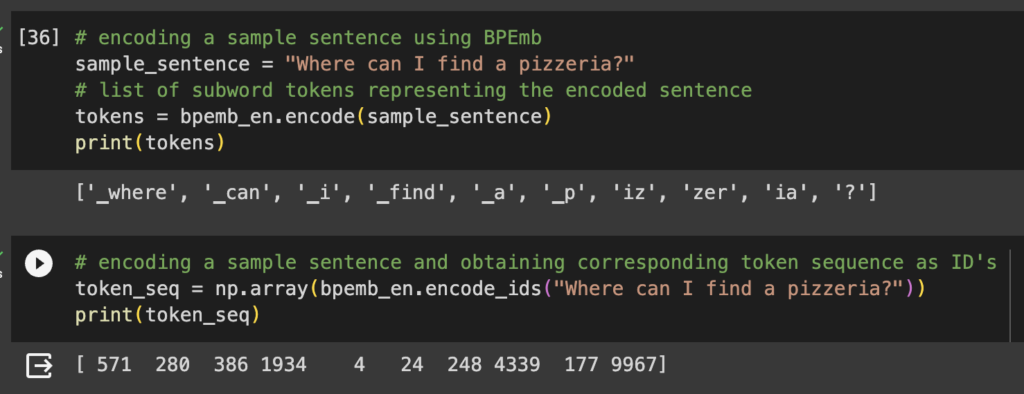
Comparison of generated embeddings
Our model’s tokenizer

Slide 8
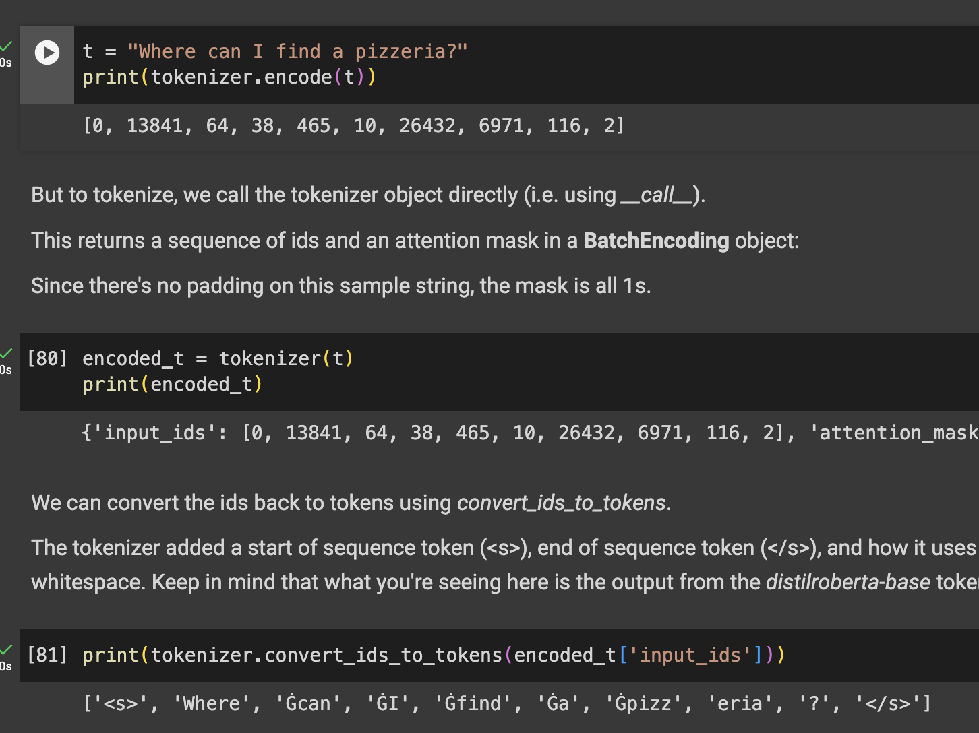
Comparison of generated embeddings (continued)
BERT tokenizer

Slide 9
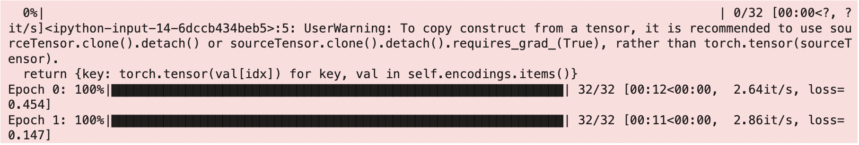
Masked Language Model
Loss obtained in the training of 2 epochs

Slide 10
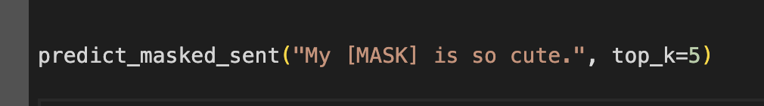
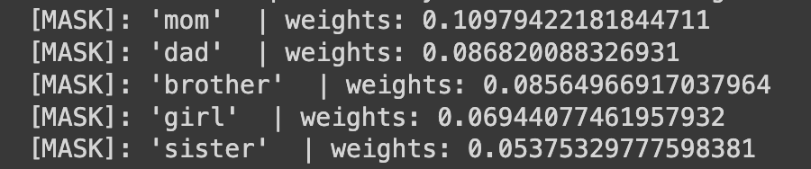
Masked Language Model

Slide 11

Next Sentence Prediction
Loss obtained in the training of 2 epochs

Slide 12
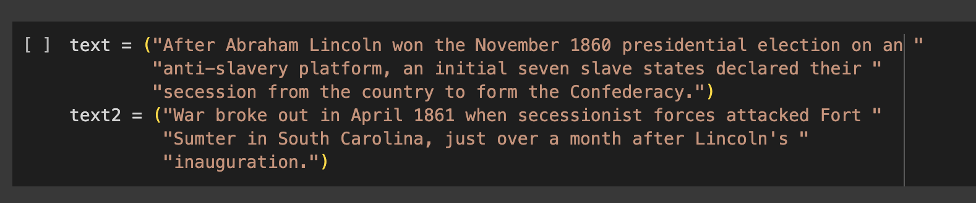
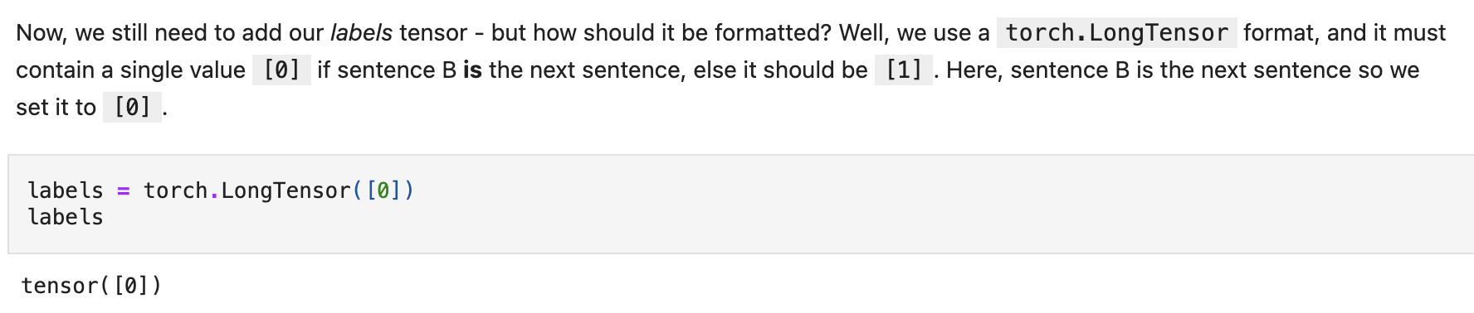
Next Sentence Prediction

Slide 13
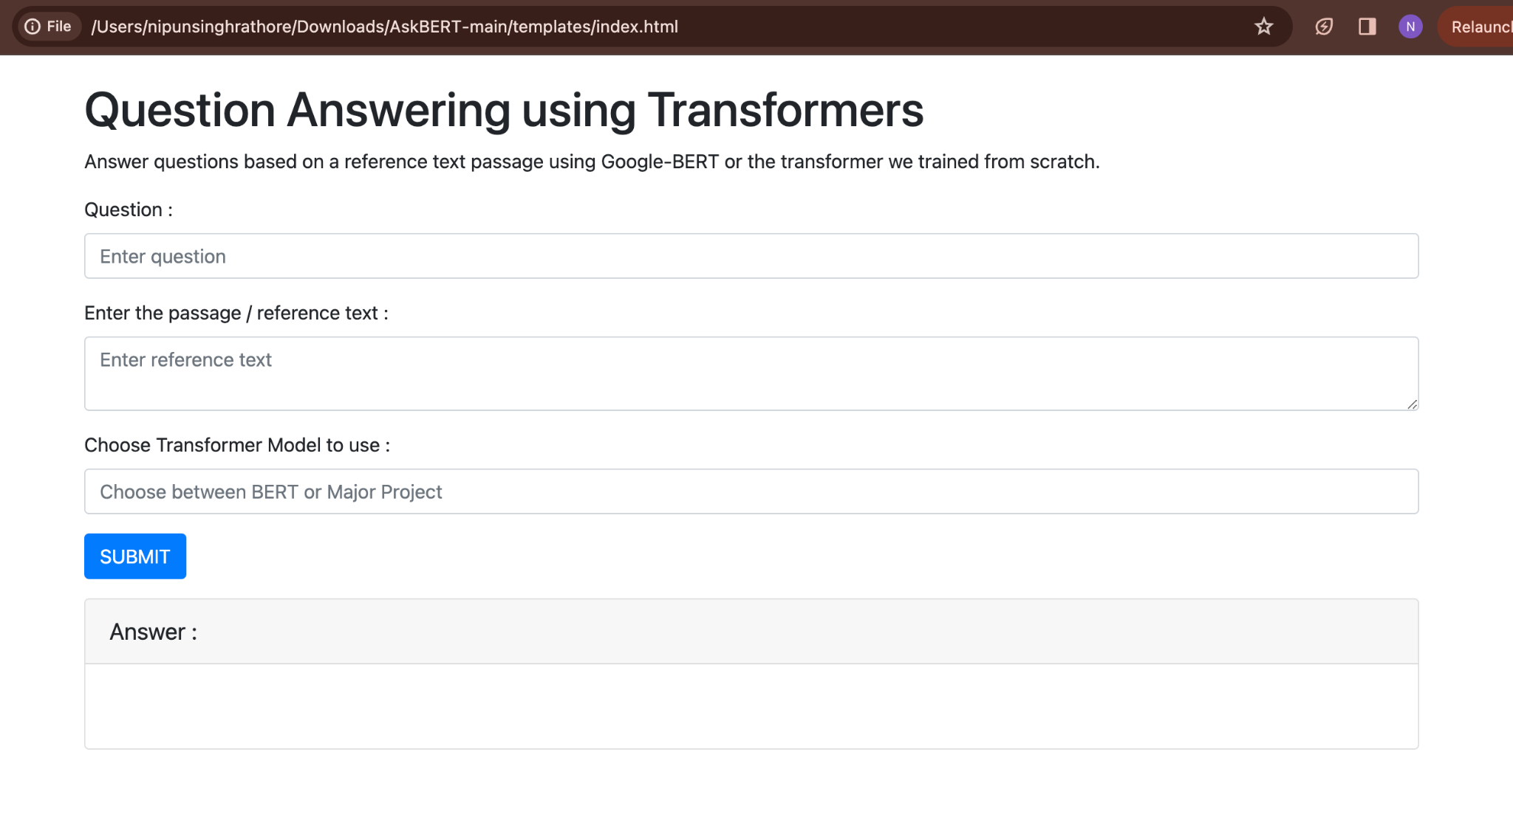
User Interface of Flask Web Application

Slide 14
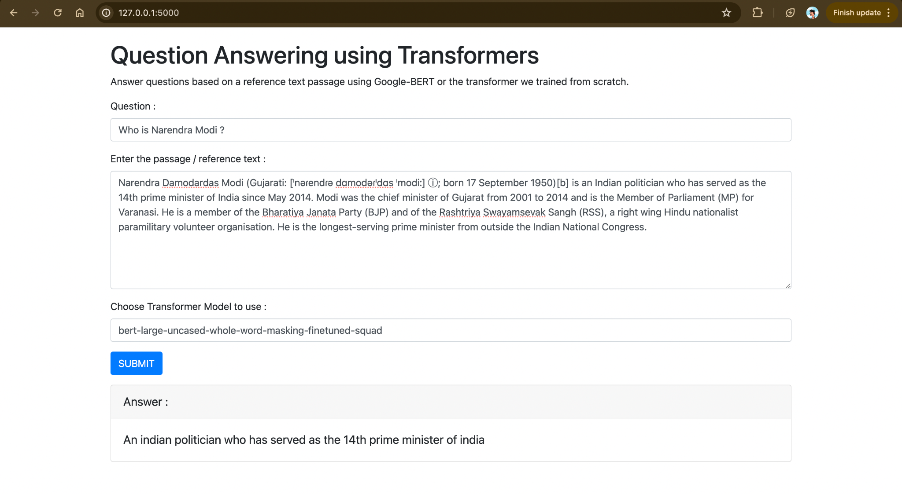
Demo of Flask Web App

Slide 15
Conclusion
In conclusion, we successfully pre-trained a transformer model from scratch, including the implementation of all its components and accomplishment of its MLM & NSP pre-training objectives.
Then, we proceeded to develop a flask web application tailored for performing question answering tasks using the pre-trained model as well as BERT.
Despite our efforts, we encountered challenges in integrating our custom model into the web application. As a result, the application currently utilizes only the BERT model for question answering task.

Slide 16
Future Work
Integration of the custom transformer model into the web application remains a priority.
Conducting thorough performance comparisons with established pre-trained transformers like BERT.
Expanding the scope of supported NLP tasks, like sentiment analysis and text classification.
Exploring fine-tuning of the transformer model on larger datasets to optimize performance for specific tasks.

